Slide 1
SMARTPHONE INSTRUMENTATION FOR COLLAPSE DETECTION OF BUILDINGS
A MOBILE CROWD-SOURCING APPROACH TOWARDS EARTHQUAKE DETECTION AND EARLY WARNING SYSTEM

Slide 2
System Organization
A two-tier mobile client-backend server architecture
Monitor and detect the collapse of buildings

Slide 3
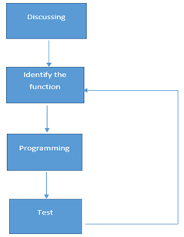
Implementation Process

Slide 4
Software Architecture
Use Case
Class Diagram
Component Architecture
System Behavior
Data Structure

Slide 5
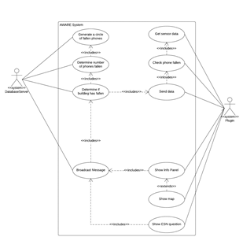
Use case
Plugin ‹‹system››
•Get sensor data
•Check phone fallen
•Send data to server
•Show Info Panel
•Show ESM question
•Show map

Slide 6
Client
Client Class Diagram
Client Component Architecture
Client Behavior
Data Structure

Slide 7
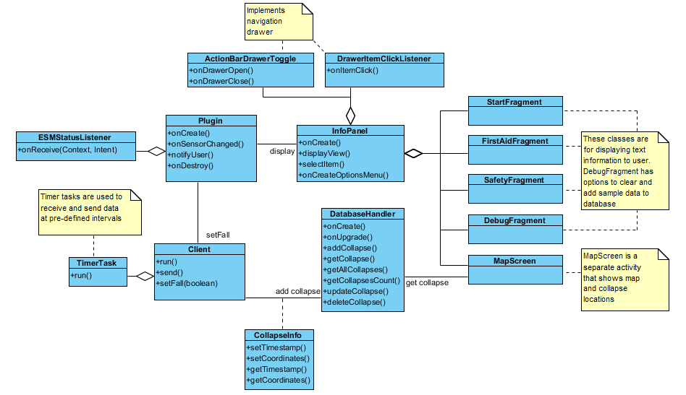
Client Class Diagram

Slide 8
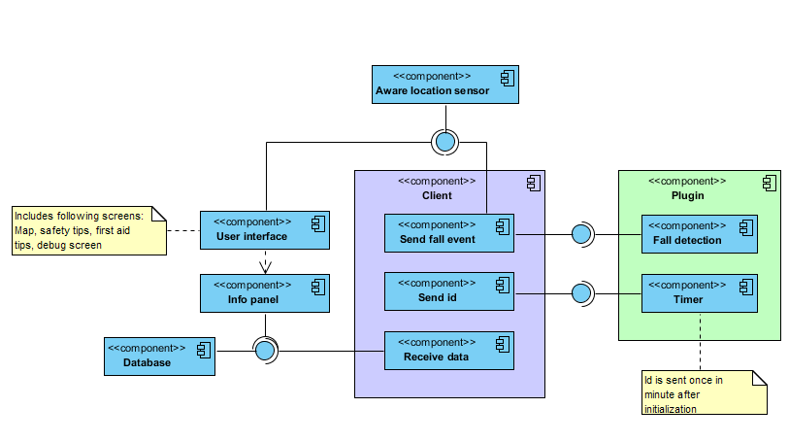
Component Architecture

Slide 9
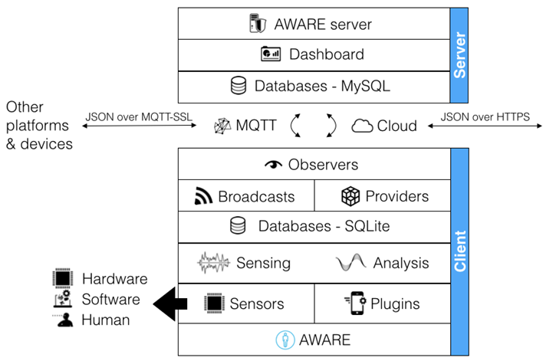
Architecture
o Platform –Android
o Logging, sharing, and reusing
o Easy Data storage and access
o Supports plugin development
o Intuitive dashboard for conducting research studies
o Programmed in Java

Slide 10
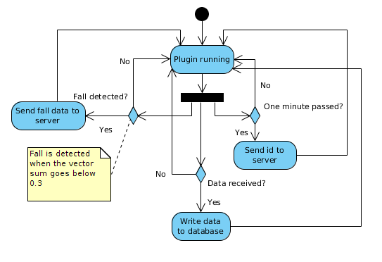
Client Behavior

Slide 11
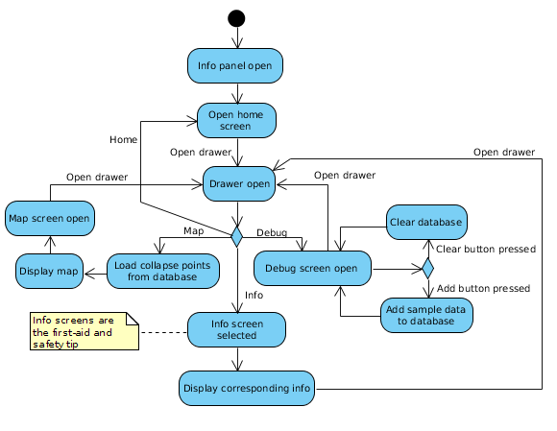
Client Behavior

Slide 12
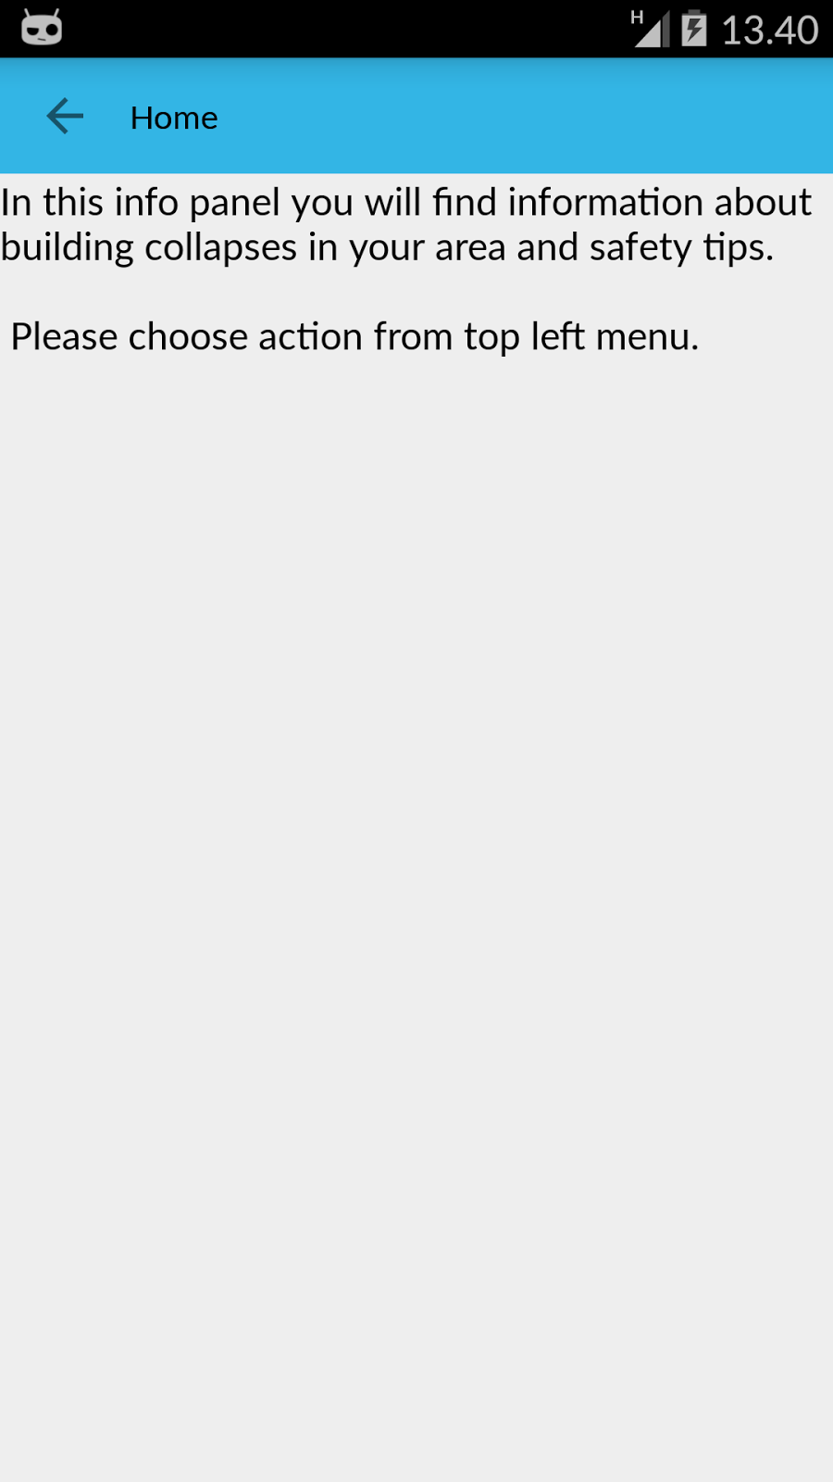
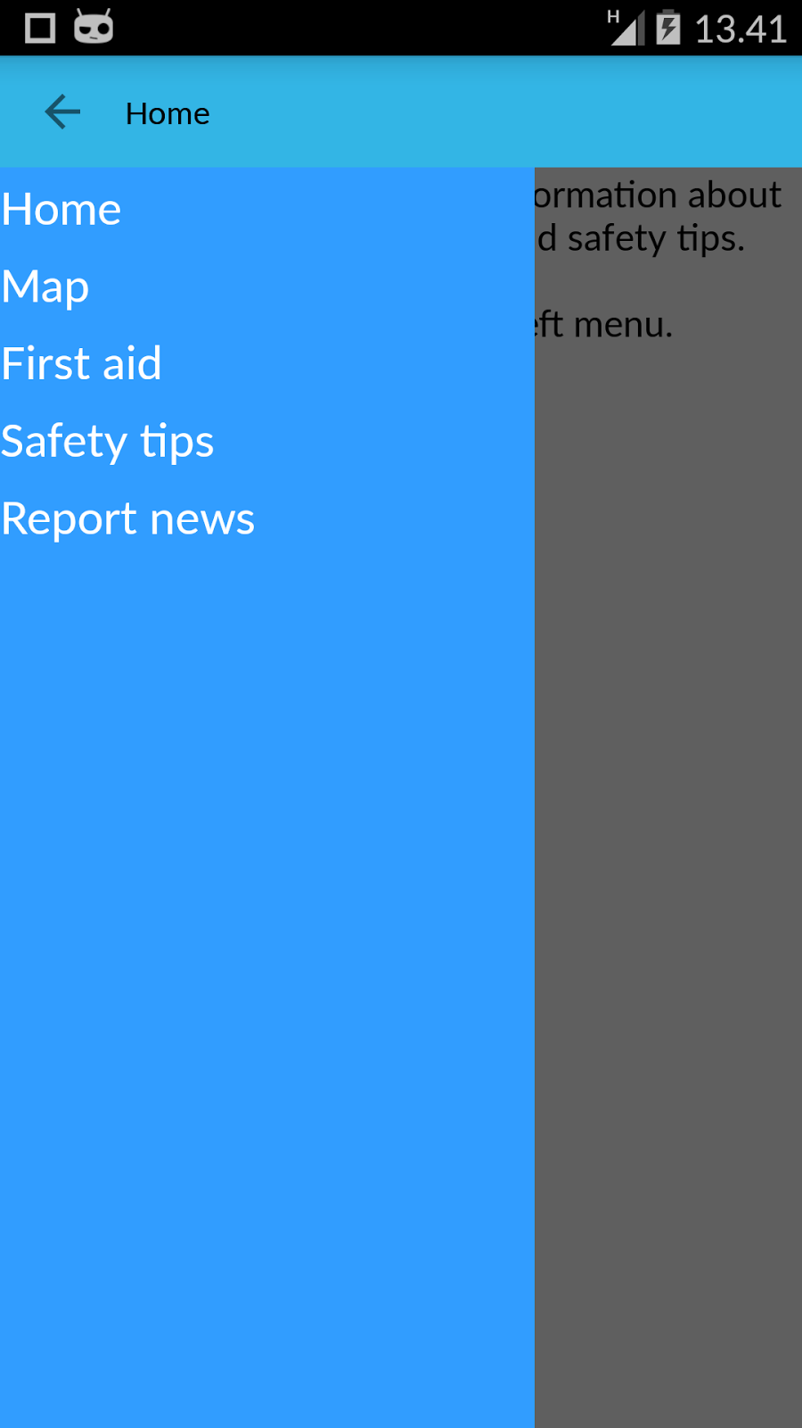
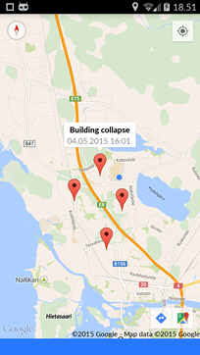
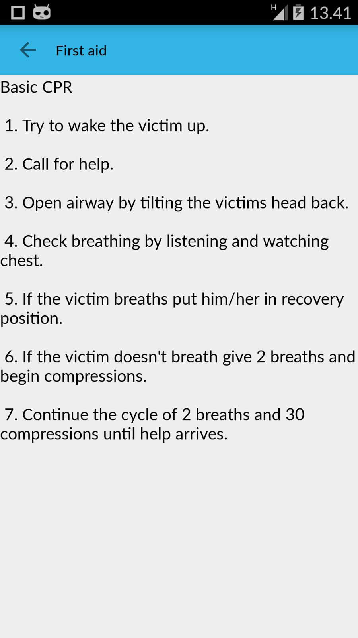
User Interface

Slide 13
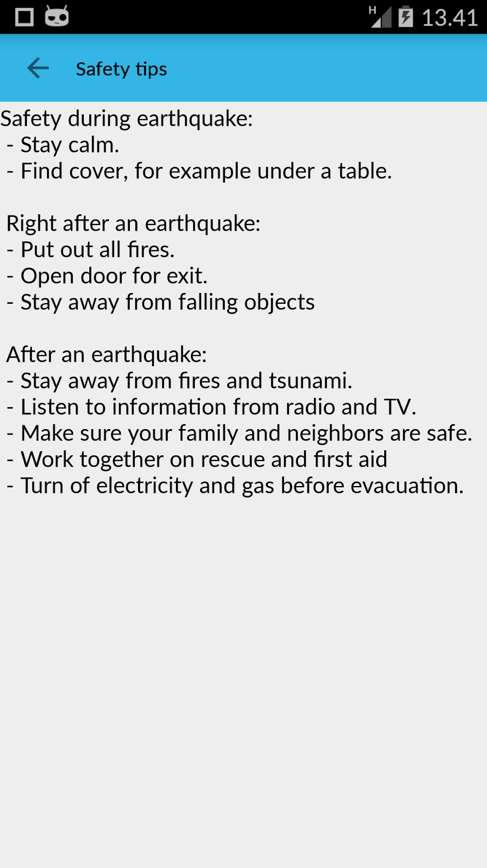
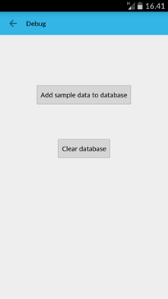
User Interface

Slide 14
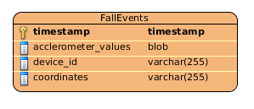

Data Structure

Slide 15
Assumptions and constraints
Assumptions:
Smartphone will be stationary
Fall detection threshold 0.3
Phone will be in free fall during collapse
Constraint:
Demanding calculations

Slide 16
Server
Server Class Diagram
Server Behavior
Data Structure

Slide 17
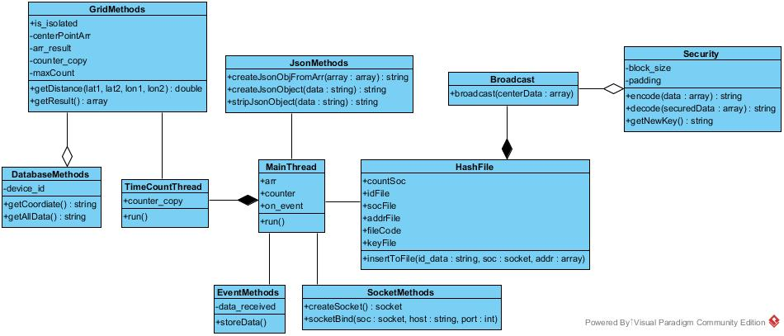
Server Class Diagram

Slide 18
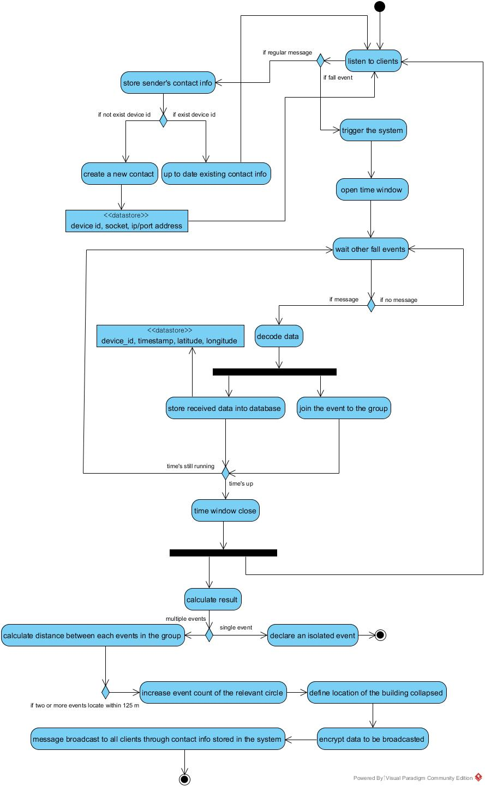
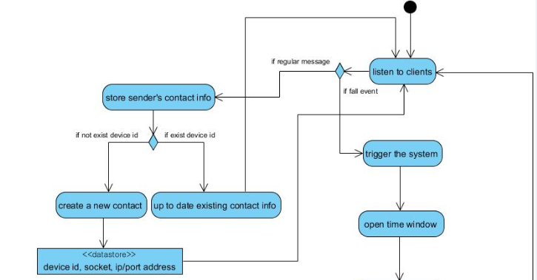
Server Behavior

Slide 19
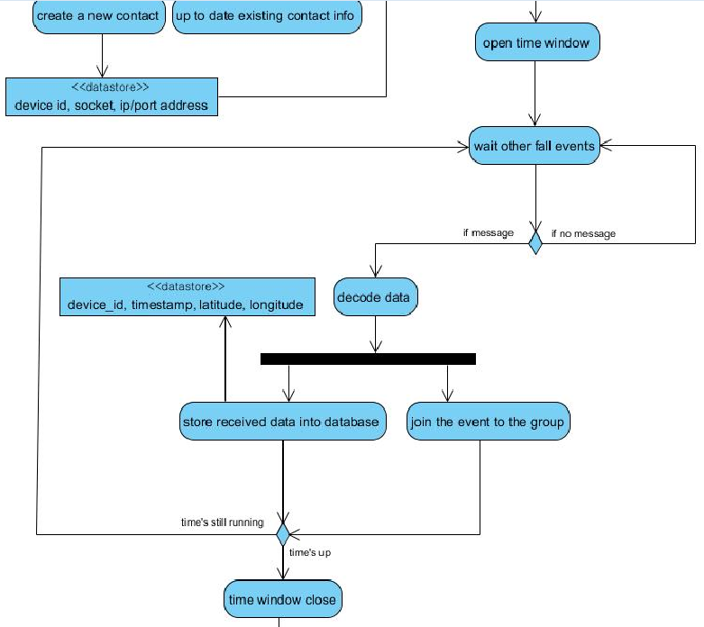
Server Behavior

Slide 20
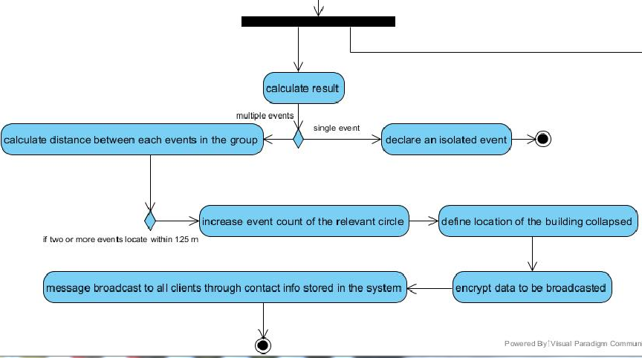
Server Behavior

Slide 21
Collapse Detect Algorithm
Case A
Case B
Case C
125 meters

Slide 22
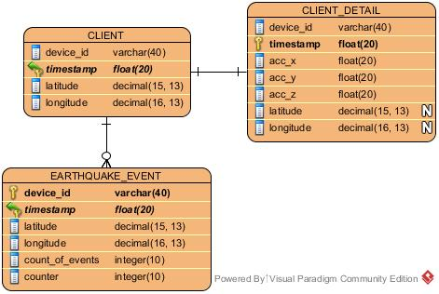
Data Structure

Slide 23
Assumptions and constraints
Assumptions:
125 m radius
10 second time window
Number of events
Constraints:
Too few phones in building

Slide 24
Security and Privacy
Data encryption using shared key
Client prepare a new shared key, send it to the server on an hourly basis
Sever maintain all the shared keys and keep it up to date
Data transmission will require encryption and decryption using the shared key
Crypto Cipher , base64 Library used

Slide 25
Risk Assessment
One group member left
Lack of experience
Time management

Slide 26
Future work
Time syncronization
Encryption
Warning message
Web user interface
More features: News reporting etc.

Slide 27
Contribution
Name | Total Work in Hours | Contribution to the Total (%)
Zeyun | 127 | 40 %
Haejong | 92 | 29 %
Perttu | 98 | 31 %
Total | 317 | 100%

Slide 28
Thank you

